Slide 3
Automation and advanced robotics
Key benefits
Advanced robotics are removing workers from hazardous tasks and dangerous environments, such as high-risk operational areas and exposures to extreme temperatures and toxic substance.​
Exoskeletons and wearable robotics support workers in physically demanding jobs to reduce physical strain and fatigue, minimizing musculoskeletal disorders.​
Automation relieves workers from repetitive or monotonous tasks, allowing them to focus on more complex and engaging work.

Slide 4
Automation and advanced robotics​ Improving OSH across sectors
Take over high-risk tasks ​in mining, construction & manufacturing
Undertake hazardous tasks remotely, reducing exposure to carcinogenic fumes, chemical spills & extreme temperatures.
Drones in agriculture​
Spray pesticides with precision and efficiency, reducing human exposure to harmful chemicals linked to cancer, poisoning and neurological damage (Borikar et al. 2022, ILO 2021b).
Robotics in healthcare​
Robots reduce radiation exposure during MRI scans & X-rays.​
Surgical robots improve precision, reduce workload, and improve ergonomics compared to traditional laparoscopic and open surgery.​
Autonomous swab robots for disease testing increase testing capacity while reducing infection risks (Haddadin et al. 2024).
Interactive robots alleviate caregiver workloads by collecting vital signs and patient data, enabling professionals to focus on complex tasks and patient care (Ragno et al. 2023). ​
AI systems in customer service​
AI-powered chatbots & virtual assistants handle complex tasks, reducing workload and stress (Babashahi et al. 2024).

Slide 5
Five Dangerous Tasks Robots Can Perform Safely (Owen-Hill 2022)​
Lifting very heavy and medium-heavy objects: Robots can lift very heavy objects, reducing strain injuries. ​
Stirring 2,000 degrees Celsius molten metal: Robot arms perform furnace tapping, avoiding worker exposure to extreme heat and sparks.​
Collecting and packaging radioactive waste: Safely collects and packages hazardous materials (e.g. radioactive waste, etc.).​
Working in unsafe environments: Replace workers in environments contaminated with dust or toxic chemicals. ​
Repeated physical motions: Prevents musculoskeletal injuries by automating high-risk repetitive motions.

Slide 6
Automation and advanced robotics
Key potential risks
Safety risks: Unexpected robotic movements due to mechanical failures or system malfunctions, along with and an over-reliance on automation, can lead to accidents.​
Ergonomic risks: Poor fit or design of exoskeletons may force unnatural or repetitive movements, causing strain, discomfort, or injury, while also introducing noise and vibration hazards.​
Psychosocial risks: Work intensification to keep pace with machines can lead to stress and fatigue, while cognitive overload may result from ensuring tasks align with complex systems. Reduced job control, autonomy, and social isolation can undermine well-being.​
Inequality & discrimination concerns: Designs that overlook needs of certain groups may create exclusion, while lower-skilled workers may experience stress and anxiety from job displacement risks, particularly if they lack reskilling opportunities.

Slide 7
Smart OSH tools and monitoring systems​
Key benefits
Monitoring technologies enable real-time hazard detection and issue immediate alerts to prevent accidents, while predictive analytics enable early identification of health and safety risks, supporting proactive OSH management.
Environmental Sensors: Track air quality, noise levels, temperature and humidity to identify workplace hazards.​
AI -Driven systems: Detect unsafe behaviours and machinery malfunctions, predicting risks that enable proactive interventions.​
Drones: Carry cameras and sensors to remotely inspect hazardous areas (e.g., disaster sites, high structures, confined spaces).​
Smart Wearable Devices: Track physiological signs (e.g., heart rate, body temperature) and environmental hazards for real-time alerts.

Slide 8
Smart OSH tools and monitoring systems​ Improving OSH across sectors
Wearable sensors & AI in Construction
Detect poor postures, unsafe lifting, and non-compliance with safety protocols, issuing real-time alerts to take timely corrective actions, preventing musculoskeletal injuries.
Implemented in Seoul Metropolitan Government Smart Safety Management system (2021), enabling early detection of safety hazards, with data analysis improving long-term safety planning.
Detect falls from heights with 100% accuracy and instantly notify emergency teams, enabling faster responses and improved survival outcomes (Dogan and Akcamete 2019).
Smart Hearing Protection in Construction
Monitor at-ear noise and environmental noise levels in real-time, allowing for detailed noise mapping beyond conventional assessments.
Used on a UK railway construction site in 2021, revealing previously unrecognized noise risks and enabling targeted interventions that reduced workplace noise exposure by 50% (British Safety Council 2024).
Temporary Workers' Safety
AI systems implemented in 2024 by a French recruitment company analyze job risks based on worker profiles and past incidents.
Employers use this data for targeted safety training and implement hazard mitigation strategies.
Smart Helmets in Mining
Detect hazardous gases, monitor temperature and pressure, and send alerts in case of removal, collision, or emergencies.
Can be paired with camaras and dust monitors, with software linking video with dust data to pinpoint high-risk zones, generating insights to reduce exposure and improve on-site safety (Centre for Disease Control and Prevention 2024).
Driver safety in construction, delivery, trucking, logistics and food services
AI-powered fleet cameras analyze real-time video to detect road and driving risks, issuing immediate alerts.
Coaching tools use data analytics to reinforce safe driving practices and address risky behaviours.

Slide 9
Smart OSH Tools and Monitoring Systems
Key potential risks
Safety risks: Overreliance on automated alerts may inadvertently encourage risk-taking and increase accident risks when systems malfunction, while a focus on immediate hazards can divert attention from underlying or long-term safety issues.
Ergonomic risks: Poorly designed wearables can result in issues related to comfort, usability, and proper fit, particularly across diverse worker populations. These challenges need to be addressed to ensure their effectiveness and avoid non-compliance.​
Psychosocial risks: Surveillance may induce stress and create a high-pressure environment, while frequent alerts can cause distraction and cognitive overload.​
Privacy & Ethical concerns: Surveillance systems risk applying automated penalties based on performance metrics, which can foster distrust and increase stress, while limited worker control over how data is collected, used, and stored raises significant ethical questions.

Slide 10
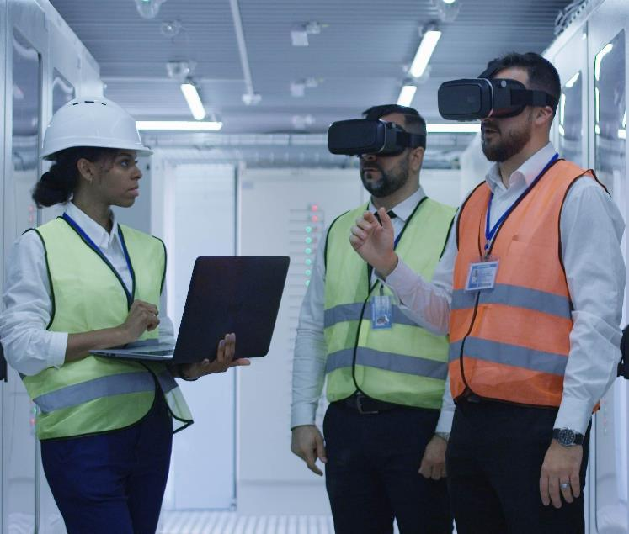
Extended and virtual reality
Key benefits
Provide immersive, risk-free training for workers to practice safety procedures and emergency responses in controlled and realistic environments.
Practicing in interactive settings which simulate real life scenarios improves skill retention and emergency preparedness.
Research show 40% of VR learners reported increased confidence compared to classroom learners, and a 35% improvement in e-learners acting on what they had learned (PWC 2020).
Virtual simulations can support inspectors to improve risk assessment and hazard identification.
Extended reality (XR) enables the creation of virtual models of work environments, helping safety professionals to identify potential risks before work begins, supporting proactive safety planning.

Slide 11
Extended and virtual reality ​ Improving OSH across sectors
Training for firefighters
In Australia, fire departments use VR technology simulate emergency scenarios.
The system generates realistic smoke, fire, water, and fire-extinguishing foam. Trainees also wear heat suits connected to software that adjusts temperature intensity, enhancing the realism and effectiveness of the training (Hoey 2024).
Improving pre-construction hazard detection
VR models future projects, helping to detect hazards in the design phase.
At an Australian water treatment plant, a pilot project using VR identified 20 hazards, compared to just 6 using traditional assessment methods. Following this success, the VR approach has been adopted in over 10 facilities, enhancing pre-construction risk mitigation (Australian Water Association 2017).
Training for labour inspectors
A VR training program launched in 2022 by Qatar Ministry of Labour and ILO enables virtual exploration of construction sites.
The initiative enhances inspectors' ability to identify risks and correct safety violations without entering hazardous environments (State of Qatar 2022)​.
Ship sanitation inspections
During COVID-19, WHO launched a VR training tool to address port health officer shortages.
It provides immersive simulations to enhance OSH knowledge, carry out sanitation assessments and risk evaluations, and allows interaction with ship crew in a controlled environment.
Benefits over 230 ports in 41 States authorised under International Health Regulations to issue sanitation certificates (WHO 2024).

Slide 12
Extended and virtual reality
Key potential risks
Safety risks: Headsets can block visibility and affect balance and coordination, increasing risk of collision, slips, trips, or falls.
Eye health risks: Prolonged exposure and proximity to screens may lead to computer vision, which includes symptoms such as eye strain, fatigue, and sleep deprivation, while light from screens may damage the retina.
Psychosocial risks: High volume of content may lead to cognitive overload and may trigger acute stress due to technological complexity and skill gaps.

Slide 13
Algorithmic management (AM) of work
Key benefits
Aligns tasks with employees' skills and preferences, promoting job satisfaction and engagement while increasing efficiency.
Optimizes schedules and workloads, ensuring workers are not overburdened and have adequate time off, lowering workplace stress and improving work-life balance.
Promotes skill development by identifying skill gaps and providing personalized training plans, mitigating anxiety related to job security.
Can addresses workplace violence and harassment by analysing communication patterns and detecting inappropriate behaviours.

Slide 14
Algorithmic management (AM) of work
Key potential risks
Safety risks: Cybersecurity threats or data breaches may compromise automated safety controls or expose workers to hazardous environments due to faulty AI-driven decision-making.
Ergonomic risks: Algorithm-driven schedules can limit movement, leading to prolonged sitting, poor posture, and increased risk of musculoskeletal disorders.
Organizational & Psychosocial risks: Constant monitoring reduces worker autonomy, impacting well-being. Work intensification to meet productivity targets increase stress and anxiety, while AI-driven performance evaluations may contribute to job insecurity. Prioritizing productivity may also lead to social isolation.
Privacy & Ethical Concerns: Ongoing data collection and surveillance raise questions about worker consent, data use, and potential automated penalties. Unfairly designed AM systems can perpetuate biases in hiring, promotions and task allocations, disadvantaging certain groups.

Slide 15
The impact of AM on job quality and working conditions in selected countries
A 2024 ILO/European Commission report studied the impact of AM practices on work organization, job quality and industrial relations in logistics and healthcare sectors in France, Italy, India and South Africa.
Positive impact on work organization in France and Italy, with no significant negative effects on job quality or increased worker surveillance.
In contrast, in South Africa and India, AM led to a decline in job quality, with clear evidence of increased monitoring, surveillance and work intensity.
Differences highlight the role of institutional and regulatory frameworks in shaping AM’s impact, emphasizing that it is the implementation, not the technology itself, that influences outcomes (ILO/European Commission 2024).

Slide 16
Changing work arrangements through digitalization
Key benefits
Remote, telework and hybrid work models
Increase flexibility, reduce commuting time, and give workers more control over their schedules, lowering stress, supporting mental health, and improving work-life balance.
Expansion of digital platforms
Up to 12% of the global labour force engages in platform work (Datta et al. 2023).
Enhance inclusion by creating opportunities for marginalized workers, including people with disabilities, mobility restrictions, and those with care responsibilities.

Slide 17
Changing work arrangements through digitalization
Key potential risks
Safety risks: Absence of regular risk assessments may expose workers to hazardous environments. Challenges arise for workers who fall outside OSH regulations, who are at an increased vulnerability to work-related injuries.
Ergonomic risks: Inadequate workstations at home and sedentary routines can lead to musculoskeletal disorders, while prolonged screen use can result in eye strain, and blue-light from screens may disrupt sleep patterns and harm retina cells.
Organizational and psychosocial risks: Work intensification due to surveillance practices and algorithmic scheduling can result in extended work hours, reduced autonomy, blurred work-life boundaries and may generate stress. Social isolation may result from limited in-person contact, weakening peer relationships and community ties. Digital spaces can exacerbate cyberbullying and digital harassment, while platform workers may be vulnerable to physical violence due to the unpredictable nature of their interactions.

Slide 18
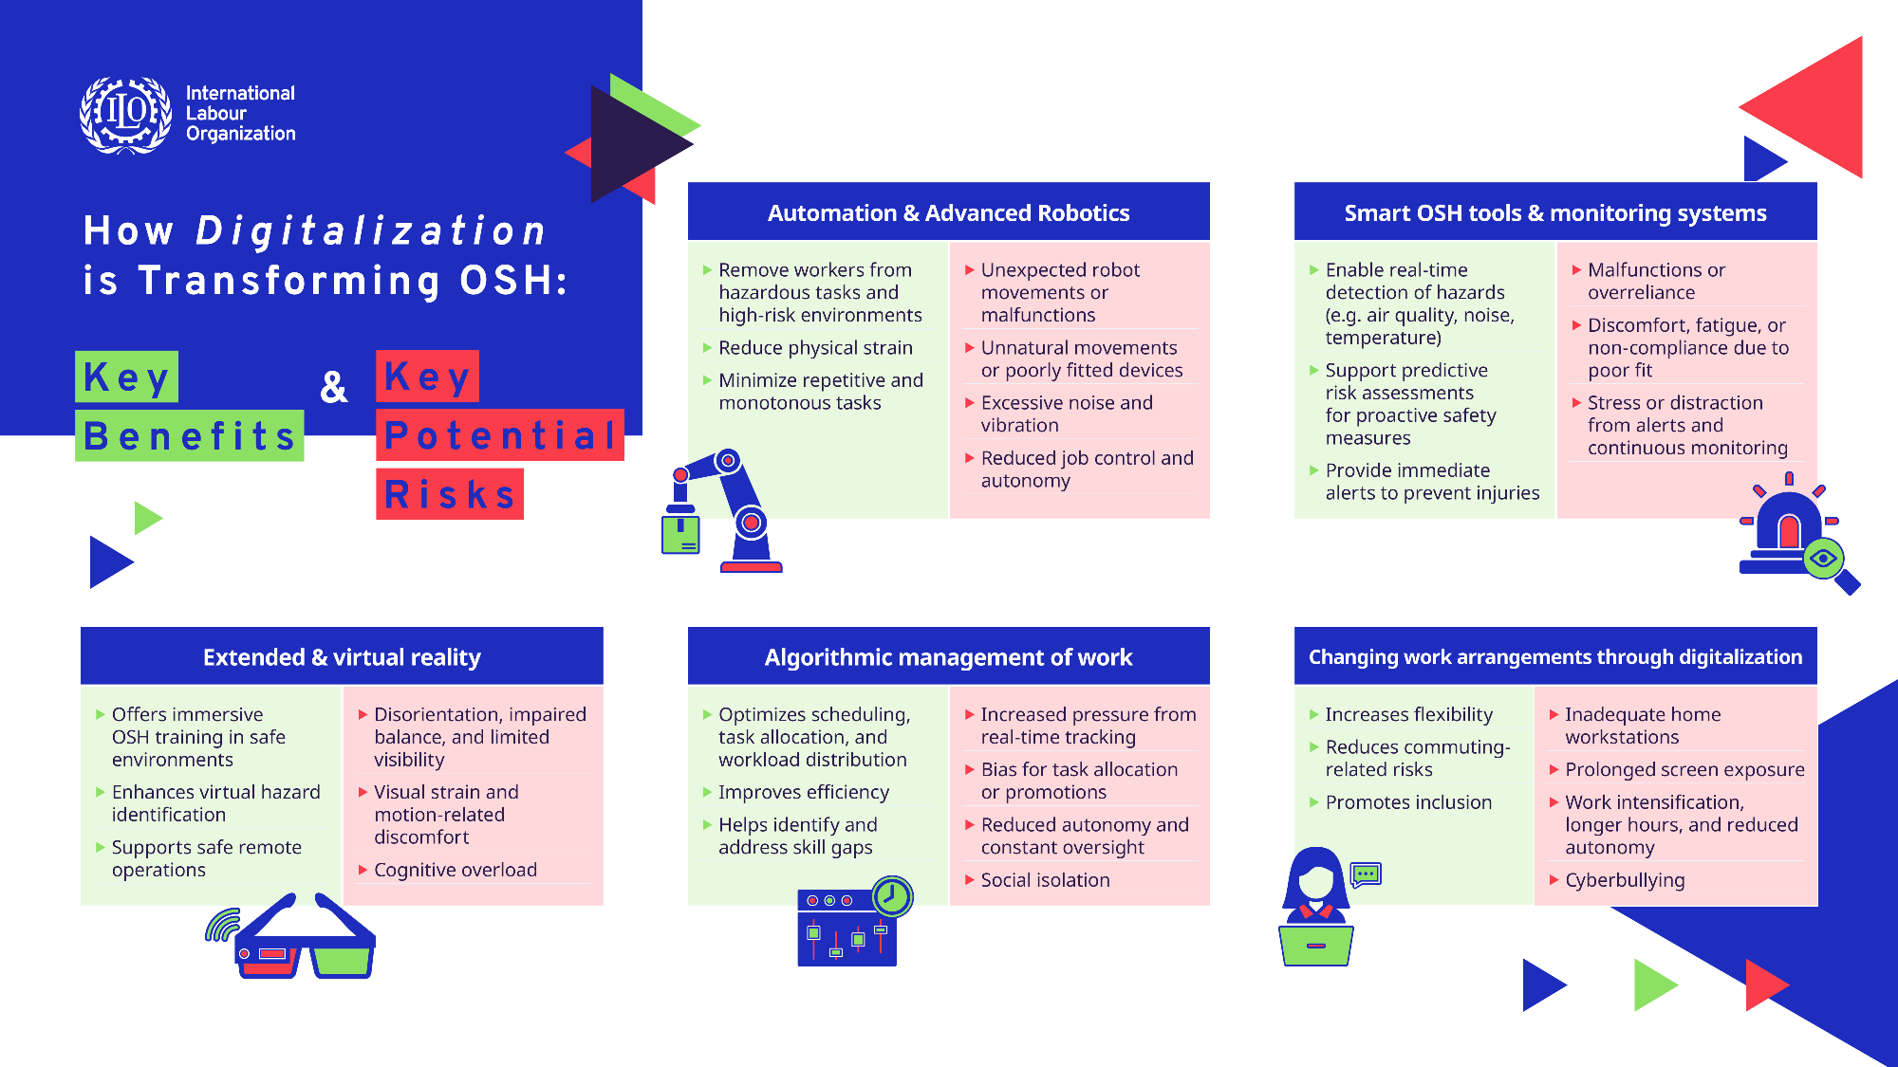

Slide 19
The digitalization supply chain: OSH considerations
The rapid expansion the digital technologies has increased pressure on workers directly contributing to the industry, many of whom lack adequate OSH protections, particularly those in the informal economy.
Workers powering digital technologies
Data Annotators:
Prepare data for AI models (label, tag, transcribe, and process).
Perform highly repetitive tasks under strict surveillance, with exploitative and unregulated conditions (Rani and Dhir 2024).
Exposed to toxic content without fair compensation or psychological support (Jensen 2024).
Content Moderators:
Analyse and remove large volumes of offensive or disturbing content (Muldoon et al. 2024).
Exposed to mental health risks, like post-traumatic stress, compassion fatigue, burnout (Rani et al., forthcoming).
Lack adequate support and may need to sign disclaimers acknowledging health risks.
Machine Learning Engineers:
Develop AI systems using large datasets and complex algorithms.
Face high stress from high volumes of complex data.
Big data analysts
Use AI, machine learning, and statistical tools to extract insights.
Challenges due to privacy, security, and governance, particularly with sensitive information (Rawat and Yadaw 2021).

Slide 20
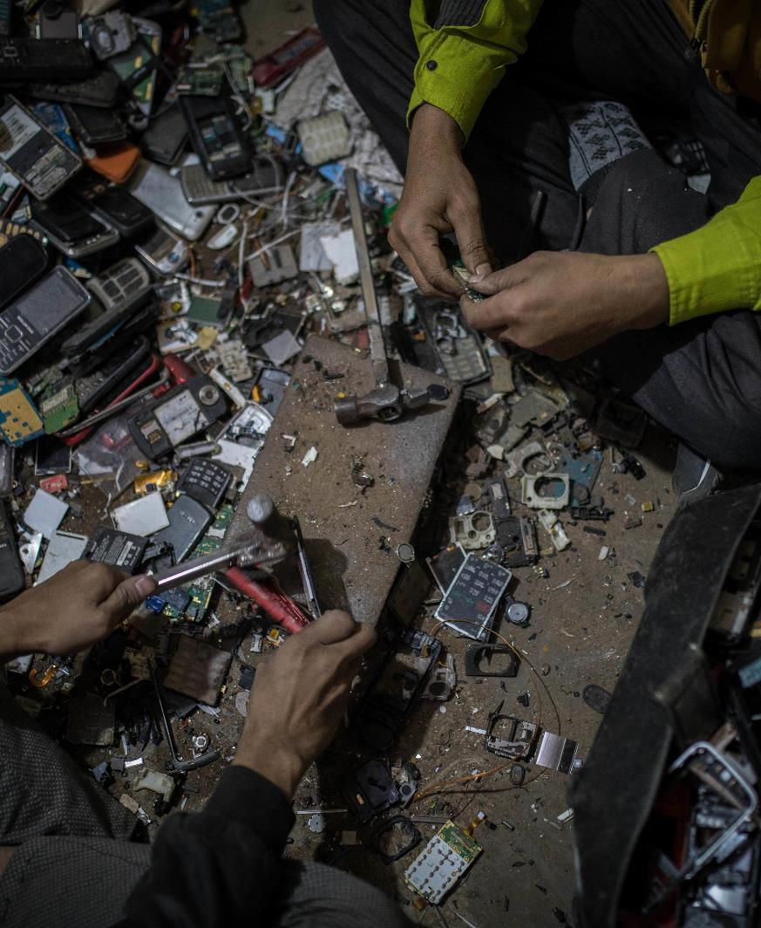
The digitalization supply chain:
OSH considerations
Workers in technology production & waste management
Miners excavating critical minerals:
Extract components for digital technologies, such as cobalt, lithium, and copper in dangerous conditions.
Rapid demand increases pressure on workers, often facing significant health risks and limited OSH protections (Landrigan et al. 2021).
Operations have been linked to child labour, safety risks, environmental abuses and corruption (Wilson Center 2021).
Factory workers in technology assembly:
Face long working hours under unsafe conditions and poor compensation (Judge 2023).
Electronic waste:
Informal workers repair, recycle, and repurpose electrical and electronic equipment.
Workers are often exposed to hazardous conditions and health risks (cancer, lung diseases and cardiovascular diseases) due to toxic chemicals and improper disposal (ILO 2021c).

Slide 21
Addressing OSH in the digital era: Policies, gaps, and collaborative efforts

Slide 22
The role of the ILO
The ILO’s fundamental OSH Conventions guarantee every worker’s right to a safe and healthy working environment, even in the context of digitalization and the evolving world of work.
Convention No. 155 outlines fundamental objectives and basic principles for comprehensive national OSH policies covering all sectors. Calls for periodic reviews to prevent occupational accidents by eliminating or minimizing hazards:
Employers should ensure new technologies are safe and do not pose health risks.
Provide adequate training and information to workers as new digital technologies are introduced.
Convention No. 187 advocates continuous improvement and responsiveness in OSH frameworks, ensuring policies remain responsive to changes in the work environment:
Emphasizes tripartite collaboration among governments, employers, and workers, ensuring their active involvement in the adoption of new technologies, ensuring that proper preventive measures are put in place.
Collaboration between governments, employers' and workers' organizations is needed to ensure that OSH policies are inclusive and address challenges posed by digitalization, balancing technological advancements with the protection of workers' safety and health.

Slide 23
The role of the ILO
Additional OSH instruments & initiatives in the digital era
Key Conventions & Recommendations:
Occupational Health Services Convention, 1985 (No. 161): Identification and assessment of workplace risks, and guidance on work organization, including the use of machinery, tools, and equipment.
List of Occupational Diseases Recommendation, 2002 (No. 194): Includes occupational diseases, covering physical agents, musculoskeletal, mental and behavioural disorders, increasingly relevant in digitalization.
Violence and Harassment Convention, 2019 (No.190): Provides a framework to prevent violence and harassment, including incidents occurring through digital technologies, relevant for preventing cyberbullying.
Future Standards:
Upcoming standard on decent work in the platform economy (2025/2026) and planned normative action for ergonomics and machine safety.
Global initiatives & research:
The ILO Global Strategy on Occupational Safety and Health 2024-2030 emphasizes the need for research and tools to navigate the opportunities and challenges of new technologies.
The ILO Observatory on Artificial Intelligence and Work in the Digital Economy aims to serve as a knowledge hub to support governments and social partners in understanding and managing the digital transformation of work.
Research projects also explore the intersection of OSH and workplace digitalization, including working conditions in digital labour platforms, the impact of AM practices, and the conditions of the hidden workforce fuelling the growth of AI.

Slide 24
International initiatives
Global initiatives:
G7 Action Plan for a Human-centred Adoption of Safe, Secure and Trustworthy AI monitors AI’s impact on OSH, includes risk assessments and audits, emphasizing the enforcement of labour laws and OSH standards.
International OSH institutions:
International Ergonomics & Human Factors Association holds webinars on AI and human-robot interaction.
Institution of Occupational Safety and Health explores how AI can enhance safety protocols, improve risk management and streamline workplace operations.
International Organization for Standardization develops standards related to information technology, AI, risk management and for the industrial and service robotics sector.
International employers’ and workers’ organizations:
International Organisation of Employers advocates for skills development and the incorporation of OSH in digital implementations. It has published reports on mental health and AI’s workplace impact.
Global trade unions advocate for stronger regulation of AI and digital surveillance, OSH protections, and collective bargaining for digital platform workers. Unions place a focus on worker participation, the protection of rights and ensuring a just transition to digitalization for workers.

Slide 25
Regional initiatives to harness OSH through digitalization
EU initiatives:
Machinery Regulation (EU) 2023/1230 - Strengthens binding health and safety requirements for advanced machinery, robotics, and AI-driven systems.
AI Regulation (EU) 2024/168941 – Introduces harmonized risk-based rules for AI systems to ensure transparency, human oversight, and minimization of health and safety risks while protecting fundamental rights.
Directive on Platform Workers (EU) 2024/283142 – Improves working conditions and regulates the use of workplace algorithms, mandating human oversight in key decisions, including dismissals.
EU-OSHA Campaign (2023–2025): “Safe and Healthy Work in the Digital Age” – raises awareness on OSH challenges of digital technologies, knowledge on key risks and opportunities, and stimulates collaboration and knowledge exchange for a safe and productive digital transformation of work.
Focus Areas: Digital platform work, advanced robotics & AI, remote & hybrid work, smart digital systems, and worker management through AI.

Slide 26
Regional initiatives to harness OSH through digitalization
Other regions:
African Union: “Digital Transformation Strategy 2020-2030” focuses on workforce digital skills, cybersecurity and ethical AI use.
ASEAN: “Digital Integration Framework Action Plan 2019-2025” guides States in the safe adoption of technologies across sectors.
Regional employers & trade unions:
ASEAN Confederation of Employers: Promotes responsible workplace AI, providing resources on managing risks, such as data biases, privacy concerns and job losses.
BusinessEurope: Advocates for skill development and training, mental health protections linked to remote work and automation and explore ways to foster trust in AI-driven systems.
Trade Union Confederation of the Americas: Produced a 2022 report advocating for smart regulation, social dialogue, and government action for achieving algorithmic management systems that improve working hours, rights, and working conditions.
Public Services International: Launched in 2021 “Our Digital Future”, a 3-year capacity building project to equip public service unions in Africa and MENA region with knowledge on digital technologies and data rights, aiming to promote safe practices.

Slide 27
National frameworks governing OSH and digitalization
Some countries are incorporating provisions related to the risks of digital technologies into their national OSH policies and strategies, acknowledging the need to protect workers and businesses from these evolving challenges and defining actions to be implemented in the coming years.
Argentina - Prevention 4.0 (2022): Uses digital tools for workplace inspections, safety training, and equipment provisions, strengthening risk management.
Finland - Work Environment Policy (2024-2030): Calls to identify, prevent and minimize emerging risks introduced by digitalization, including robotics, AI and automation.
Guyana - OSH Policy (2018): Advocates for the use of modern technology and systems while taking into account their impact.
India - OSH & Environment Policy (2023): Recognizes emerging risks while promoting implementation of computer-aided risk assessment tools to improve risk management.
Uruguay - OSH Policy (2024): Aims for the update of regulations to reflect new technologies and the changing world of work.

Slide 28
Regulatory framework addressing potential risks arising from new technologies
Existing OSH laws broadly protect workers but often prioritize physical risks rather than psychosocial hazards, which are an increasing concern from digitalization and AI.
New regulations aim to fill gaps while ensuring the safe implementation of digital technologies.
Automation and advanced robotics:
Argentina (Resolution 69/2024): Modernizes workplace risk prevention via digital tools, empowering departments to set implementation guidelines for technology-driven safety measures.
France (Digital Labour Code): Incorporates rules on robot-assisted work to minimize risks in human-robot collaboration, ensuring safety while addressing ethical concerns.
Germany (DGUV Standards 100-500, 2024): Sets mandatory requirements for employers using industrial robotics, ensuring risk assessments and safety measures are in place.
Right to disconnect:
Enacted in Luxembourg (2023) and multiple countries (France, Canada, Germany, etc.) to reduce burnout and digital surveillance.
Regulate the use of work-related communications outside working hours, safeguarding workers’ personal time and mental health.
Telework & digital platform:
Since beginning of COVID-19, Austria, Greece, Latvia, Portugal, Romania, Slovakia and Spain have introduced telework legislation. Some legislations place focus on the correct classification of platform workers to extend OSH protections.

Slide 29
Regulatory framework addressing potential risks arising from new technologies
Collective bargaining agreements:
Norway: A 2016 Telenor collective agreement between the Confederation of Norwegian Enterprise and the Norwegian Confederation of Trade Unions addresses the use of AI in the workplace, stating employees must be kept informed and that AI workplace controls must be justified and transparent.
Spain: A 2023-2024 collective agreement with Tekniker ensures employees’ right to disconnect, prohibiting work-related communications outside working hours.
Sweden: In Kurina Mine, a 2022 agreement ensures that the use of a smartphone application with AI surveillance is limited to safety purposes and not to track or measure productivity.
UK: In 2019, GMB union reached a deal with Hermes to address algorithmic fleet management, granting unions the right to conduct health and safety assessments after incidents, allowing to identify cases where AM raises safety concerns.
Germany: In 2022, UNI Global Union’s affiliate ver.di signed a 3-year digitalization agreement for H&M workers that reinforces their participation rights on issues related with digitalization.
Labour inspectorates:
Mexico’s Secretariat of Labour and Social Welfare: Uses an AI-driven hazard projection model that analyses 1.5 million past inspections to identify areas with higher probability of non-compliance. Can also detect patterns related to occupational diseases and risks for preventive action.
Norwegian Labour Inspection Authority: Developed a predictive analytics tool that utilizes big data to identify high risk-companies for health and safety inspections, targeting inspections more effectively.

Slide 30
Voluntary standards and technical guidelines
Enhancing OSH with digital tools:
Argentina: Libro Blanco – Strategies for using digitalization, AI, and data analysis tools to modernize OSH practices.
Canada (British Columbia): WorkSafeBC – Toolkit to track injuries and claims data, integrating OSH into financial planning.
France: AI for OSH 2035 – Explores AI’s role in accident prevention and improvement of workplace safety.
Addressing OSH risks in digitalization, automation and robotics:
Australia: Guidelines for Safe Collaborative Robots – Risk assessments, workplace checklists.
USA: Industrial Robot Safety Standards – Continuous updates for collaborative robotics.
Chile: Work Digitalization & Automation Guide – Includes risk management for ergonomics, data handling and automation.
New Zealand: Automation & Robotics Guidelines – Active involvement of workers, training and safety audits.
Ireland: Psychosocial Risk Assessment – Support for those exposed to sensitive content (i.e. content moderators).
Guidance by employer’ organizations:
USA: Robotic Industries Association – Safety standards for industrial mobile robots and guidance on risk mitigation.
Japan: Robotics Safety & Training Program – Risk assessments and safety management for service robots.

Slide 31
Training programmes
Public authorities and other bodies are supporting employers and workers in addressing the risks associated with digital technologies in the workplace.
Brazil: Social Service of Industry – Safe interaction with AI and robotics, focusing on ergonomics and mental health.
Canada: Workplace Safety & Prevention Services – AI and robotics safety training in high-risk sectors (e.g. construction, logistics and manufacturing).
Chile: ChileValora – AI and robotics safety training for mining, manufacturing, and energy workers.
United Arab Emirates: National AI Program – AI training for public sector employees managing AI integration.
Poland: Central Institute for Labour Protection – Training on the safe integration of AI and robotics in manufacturing, logistics and healthcare, including risk assessments, ergonomic considerations, and the mitigation of psychosocial risks.
Singapore: Workplace Safety & Health Council – Certification for AI and robotics safety in high-risk sectors (e.g. construction and logistics).

Slide 32
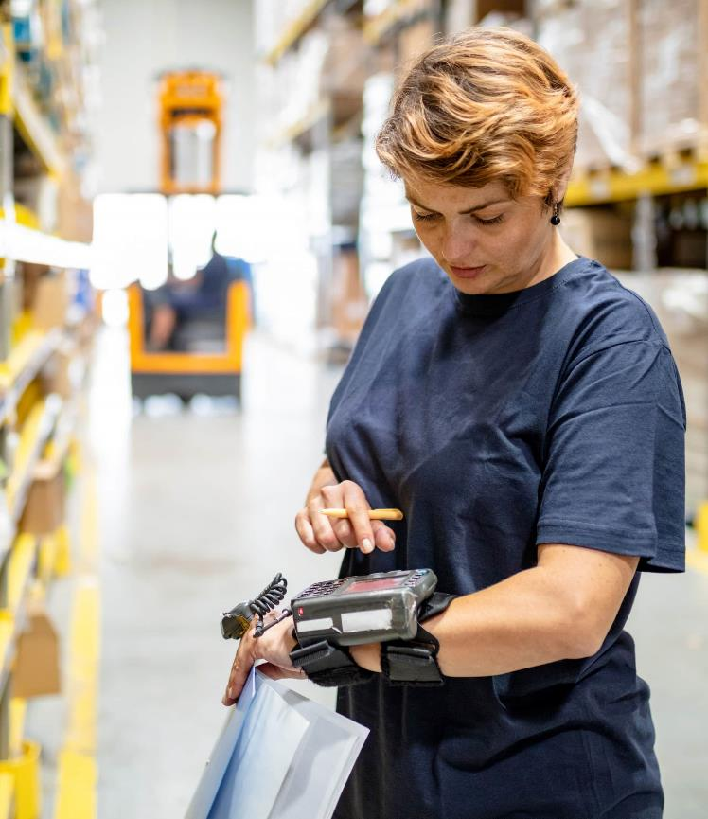
Research on the OSH implications of digitalization
Generate evidence-based insights to guide digital transformation in workplaces.
Austria: Work NEW 4.0 - AI & automation’s impact on OSH, collaboration between academia & industry.
Canada: IRSST Bulletin – Regular AI & OSH research updates for stakeholders.
Chile: Social Security Superintendence Authority – Funds research on AI & wearables for real-time safety monitoring.
New Zealand: Robotics, Automation & Sensing Network - Conferences on digital workplace safety.
Sweden: Karolinska Institute New World of Work – Investigates the impact of algorithmic systems on worker well-being, considering negotiations carried out when they are implemented.
USA: NIOSH AI & Robotics Research - Grants for AI-driven safety innovation, accident prevention, & exoskeletons to reduce injury risks.

Slide 33
Managing Digitalization and OSH at the Workplace
Implementing a comprehensive OSH management system
Key elements (ILO OSH 2001 Guidelines):
Policy development: Through a tripartite process, formulate clear OSH policy that reflects commitment to safety and health, including when new technologies and processes are integrated.
Organizing: Defined roles and responsibilities for OSH, promoting active worker participation and consultation, particularly in the integration of new technologies and related OSH measures.
Planning & implementation: Systematic identification of hazards and risks and implementation of preventive and protective measures, tailoring these to the risks associated with new technologies.
Evaluation: Monitor and measure OSH performance and regularly ensure compliance with OSH standards through audits and ensure effectiveness of controls related to new technologies.
Improvement: Corrective actions based on evaluations for improvement, revising OSH policies and procedures to address evolving risks posed by technological changes.
Effective workplace action, rooted in a strong safety culture and active worker participation, is essential to ensure that new technologies enhance—not compromise—worker safety and wellbeing.
A collaborative, tripartite approach involving workers, employers, and governments allows the shaping of safer and more responsive work environments.

Slide 34
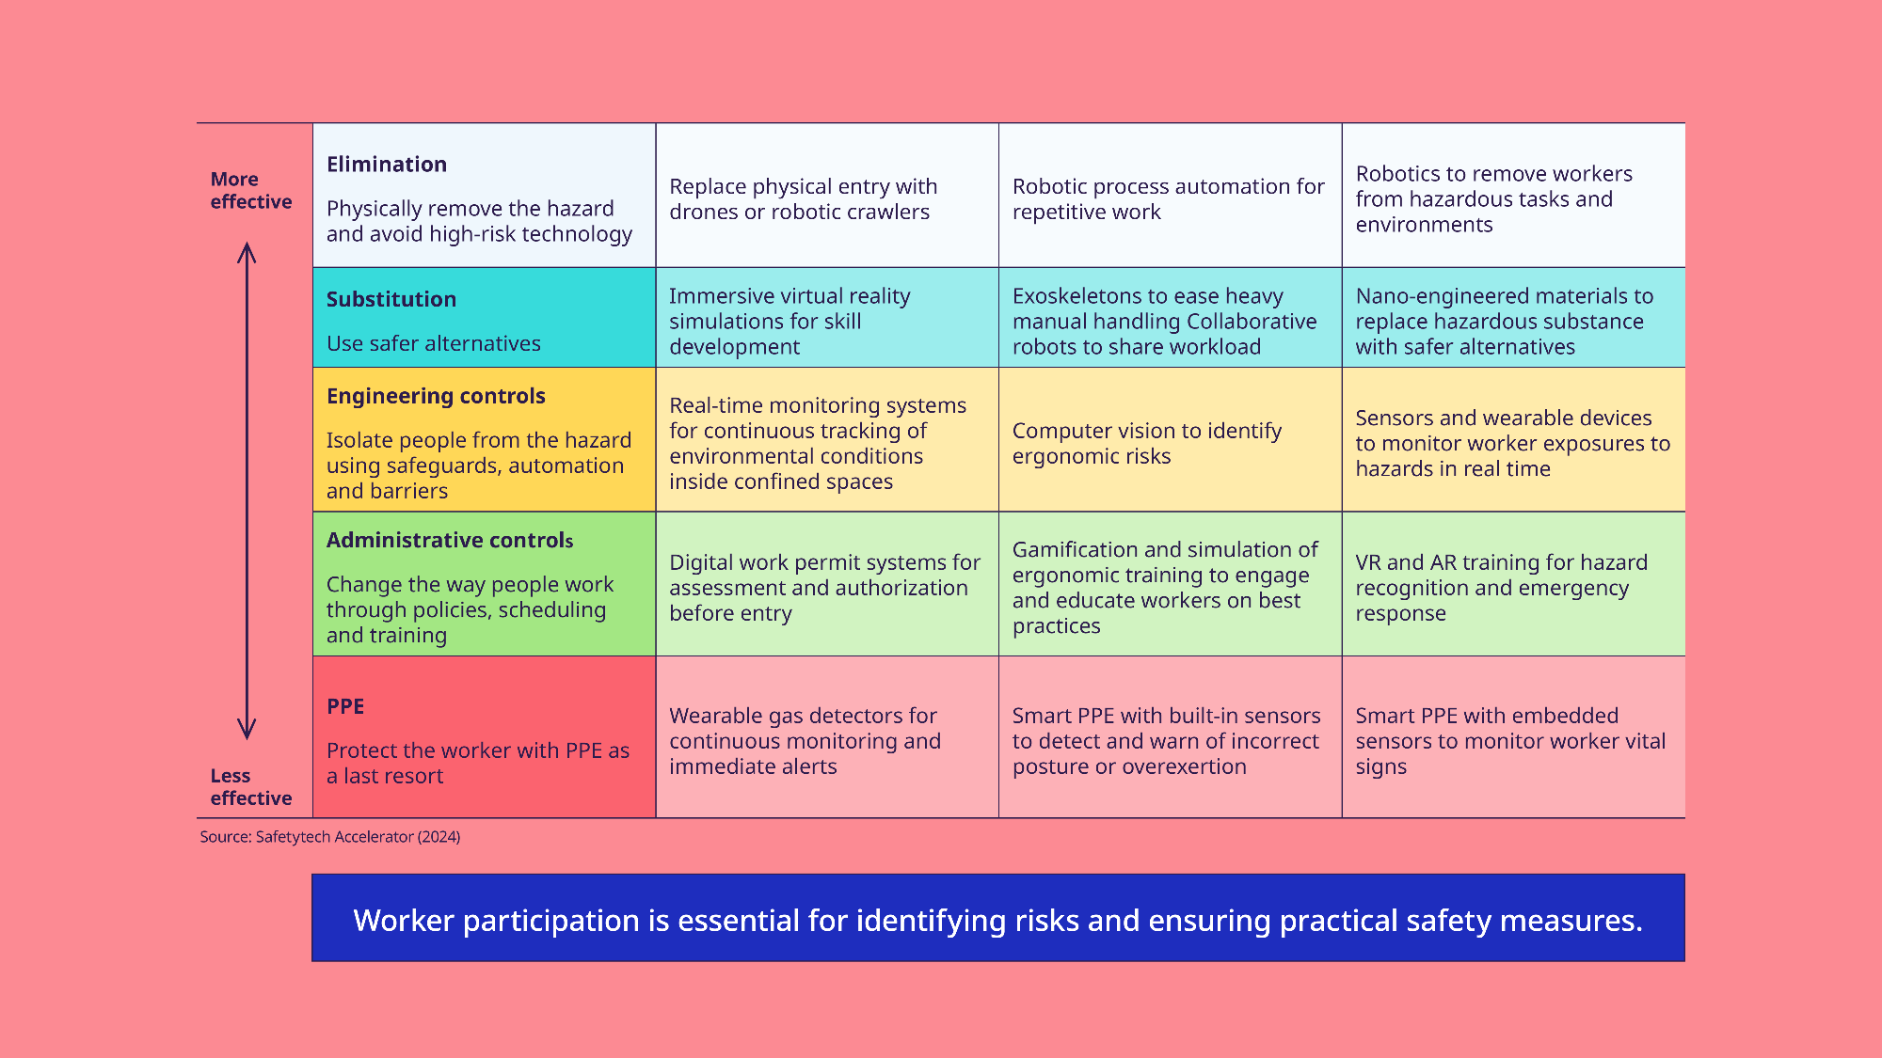
Integrating new technologies into risk management for improved OSH

Slide 35
Key Takeaways
Automation & advanced robotics: Reduce hazardous exposures, prevent musculoskeletal disorders, and eliminate repetitive and monotonous tasks.
Smart OSH tools & monitoring systems: Enable real-time hazard detection and predictive analytics support proactive OSH management.
Extended & virtual reality: Support trainings and inspections, improving hazard identification and emergency preparedness.
Algorithmic management of work: Optimize scheduling, task allocations, workload distributions, and workforce management.
Changing work arrangements: Expand job access, increase flexibility, and enhance work-life balance.
Further research is needed to understand the long-term OSH impacts of digital technologies and ensure informed implementation.
More data on both potential benefits and negative OSH impacts across sectors is needed, including the decrease or increase in work-related injuries and diseases.
More collaboration between governments, academia and social partners is needed to address research gaps and support evidence-informed strategies to ensure safe and healthy digitalized workplaces.

Slide 36
References
Australian Water Association. 2023. “Melbourne Water Grabs Gong for VR Tech Use in Hazard Identification.” Australian Water Association, November 9, 2023. https://www.awa.asn.au/resources/latest-news/technology/innovation/melbourne-water-grabs-gong-for-vr-tech-use-in-hazard-identification
Babashahi, Leili, Carlos Eduardo Barbosa, Yuri Lima, Alan Lyra, Herbert Salazar, Matheus Argôlo, Marcos Antonio de Almeida, and Jano Moreira de Souza. 2024. “AI in the Workplace: A Systematic Review of Skill Transformation in the Industry”. Administrative Sciences 14 (6): 127. https://doi.org/10.3390/admsci14060127.
Borikar, Ganesh P., Chaitanya Gharat, and Sachin R. Deshmukh. 2022. “Application of Drone Systems for Spraying Pesticides in Advanced Agriculture: A Review”. IOP Conf. Ser.: Mater. Sci. Eng. 1259 012015. https://doi.org/10.1088/1757-899X/1259/1/012015.
Centers for Disease Control and Prevention. 2024. “NIOSH-Developed Tools for Monitoring Respirable Crystalline Silica in the Mining Environment | Blogs | CDC.” Cdc.gov. November 4. https://blogs.cdc.gov/niosh-science-blog/2024/11/04/monitoring-rcs-mining/.
Datta, Namita, Chen Rong, Sunamika Singh, Clara Stinshoff, Nadina Iacob, Natnael Simachew Nigatu, Mpumelelo Nxumalo, and Luka Kimaviciute. 2023. Working Without Borders: The Promise and Peril of Online Gig Work. Washington, DC: World Bank. https://openknowledge.worldbank.org/entities/publication/ebc4a7e2-85c6-467b-8713-e2d77e954c6c.
Dogan, Onur, and Asli Akcamete. 2019. “Detecting Falls-from-Height with Wearable Sensors and Reducing Consequences of Occupational Fall Accidents Leveraging IoT”. In Advances in Informatics and Computing in Civil and Construction Engineering, edited by Ivan Mutis and Timo Hartmann, 207–14. Cham: Springer International Publishing. https://doi.org/10.1007/978-3-030-00220-6_25.
Haddadin, Simon, Dirk Wilhelm, Daniel Wahrmann, Fabio Tenebruso, Hamid Sadeghian, Abdeldjallil Naceri, and Sami Haddadin. 2024. “Autonomous Swab Robot for Naso- and Oropharyngeal COVID-19 Screening”. Scientific Reports 14 (January):142. https://doi.org/10.1038/s41598-023-50291-1.
Hoey, Iain. 2024. “FLAIM Systems highlights immersive learning technology to boost recruitment in fire departments”. International Fire & Safety Journal. https://internationalfireandsafetyjournal.com/australian-fire-departments-adopt-immersive-learning-toaddress-recruitment-challenges/.
ILO 2021b. Exposure to Hazardous Chemicals at Work and Resulting Health Impacts: A Global Review. https://www.ilo.org/ publications/exposure-hazardous-chemicals-work-and-resulting-health-impacts-global (International Labour Organization, 2021).
ILO 2021c. Teleworking Arrangements during the COVID-19 Crisis and Beyond. https://www.ilo.org/publications/teleworkingarrangements-during-covid-19-crisis-and-beyond (International Labour Organization, 2021).
ILO. 2021e. World Employment and Social Outlook. The Role of Digital Labour Platforms in Transforming the World of Work. https://www.ilo.org/publications/flagship-reports/role-digital-labour-platforms-transforming-world-work (International Labour Organization, 2021).
ILO. 2024c. Realizing Decent Work in the Platform Economy. https://www.ilo.org/sites/default/files/2024-07/ILC113-V%281%29-%5BWORKQ-231121-002%5D-Web-EN.pdf (International Labour Organization 2024).
ILO/European Commission. 2024. Algorithmic Management Practices in Regular Workplaces: Case Studies in Logistics and Healthcare. https://www.ilo.org/publications/algorithmic-management-practices-regular-workplaces-case-studies-logistics (International Labour Organization and European Commission, 2024).
Jensen, Beth. 2024. “Exploring the Complex Ethical Challenges of Data Annotation”. https://hai.stanford.edu/news/exploringcomplex-ethical-challenges-data-annotation. 10 July 2024.
Judge, Ladan. 2023. “What Is Forced Labor in the Technology Industry Supply Chain?” https://www.z2data.com/insights/what-isforced-labor-in-the-technology-industry-supply-chain (Z2Data, 2023).
Landrigan, Philip, Stephan Bose-O’Reilly, Johanna Elbel, Gunnar Nordberg, Roberto Lucchini, Casey Bartrem, Philippe Grandjean, Donna Mergler, Dingani Moyo, Benoit Nemery, Margrit von Braun, and Dennis Nowak on behalf of the Collegium Ramazzini. 2022. “Reducing Disease and Death from Artisanal and Small-Scale Mining (ASM) - the Urgent Need for Responsible Mining in the Context of Growing Global Demand for Minerals and Metals for Climate Change Mitigation”. Environmental Health 21 (1): 78. https://doi.org/10.1186/s12940-022-00877-5.
Muldoon, James, Mark Graham, and Callum Cant. 2024. Feeding the Machine. The Hidden Human Labour Powering AI. Bloomsbury Publishing.
Owen-Hill, Alex. 2022. “Five Highly Dangerous Jobs That Robots Can Do Safely”. In Smart Manufacturing, 415–18. John Wiley & Sons, Ltd. https://doi.org/10.1002/9781119846642.other8.
Persson, Marcus, David Redmalm, and Clara Iversen. 2021. “Caregivers’ Use of Robots and Their Effect on Work Environment – a Scoping Review”. Journal of Technology in Human Services 40 (3): 251–77. https://doi.org/10.1080/15228835.2021.2000554.
PWC. 2020. “PwC’s Study into the Effectiveness of VR for Soft Skills Training”. https://www.pwc.co.uk/issues/technology/immersive-technologies/study-into-vr-training-effectiveness.html (PwC, 2020).
Ragno, Luca, Alberto Borboni, Federica Vannetti, Cinzia Amici, and Nicoletta Cusano. 2023. “Application of Social Robots in Healthcare: Review on Characteristics, Requirements, Technical Solutions”. Sensors 23 (15): 6820. https://doi.org/10.3390/s23156820.
Rani, Uma, and Rishabh Kumar Dhir. 2024. “AI-Enabled Business Model and Human-in-the-Loop (Deceptive AI): Implications for Labor.” In Handbook of Artificial Intelligence at Work, edited by Martha Garcia-Murillo, Ian MacInnes, and Andrea Renda, 47–75. Cheltenham, UK; Northampton, MA: Edward Elgar Publishing. https://doi.org/10.4337/9781800889972.00011.
Rani, Uma, Morgan, Williams, and Nora Gobel. Forthcoming. The Human Cogs in the AI Machine: Experiences of Data Annotation and Content Moderation Workers in the BPO Sector in India and Kenya. ILO Working Paper.
Rawat, R., and R. Yadav. 2021. “Big Data: Big Data Analysis, Issues and Challenges and Technologies”. IOP Conference Series: Materials Science and Engineering 1022: 012014. https://doi.org/10.1088/1757-899X/1022/1/012014.
Seoul Metropolitan Government. 2021. Seoul Adopts AI & IoT Safety Management to Prevent Construction and Building Accidents. September 24, 2021. https://english.seoul.go.kr/seoul-adopts-ai-iot-safety-management-to-prevent-construction-and-building-accidents/
State of Qatar, Ministry of Labour. 2022. “Ministry of Labour Launches Training Program for Inspectors Using VR Technology”. 2022. https://www.mol.gov.qa/En/mediacenter/Pages/NewsDetails.aspx?itemid=65.
WHO. 2024. “WHO Launches an Innovative Virtual Reality Training Tool on Ship Sanitation Inspection”. https://www.who.int/europe/news/item/03-01-2024-who-launches-an-innovative-virtual-reality-training-tool-on-ship-sanitation-inspection (World Health Organization, 2024).
Wilson Center. 2021. “The DRC Mining Industry: Child Labor and Formalization of Small-Scale Mining”. https://www.wilsoncenter.org/blog-post/drc-mining-industry-child-labor-and-formalization-small-scale-mining (Wilson Center, 2021).

